Slide 1

HEART STROKE PREDECTION
Member Name | Roll | Program
Nitin Kumar | 2001840003 | Bsc.(H) Data Science
Rohit Kumar | 2001840008 | Bsc.(H) Data Science
Project Mentor: Dr. Meenu Vijarania

Slide 2

HEART STROKE PREDECTION

Slide 3
Project Idea
According to survey over 3 million people losses their life due to heart stroke and heart attack per year.
Heart stroke is found to be a dominant reason that loses their life due to heart related diseases.
To overcome the issues of death due to heart stroke, predictive modelling approach can be used to collect the data with multiple methods that find the root causes of heart stroke which will help to reduce the deaths due to heart stroke.
high blood pressure is also found to be one more cause for heart stroke disease.
In the case of a prediction model, it is also necessary to take into consideration factors like age, gender, bmi(Body Mass Index) , other illnesses if present, medical history, drinking and smoking habits, level of glucose, type of work the person performs, etc.

Slide 4
Project Objectives
The main objective of the project is to develop a heart prediction system , the system can discover and extract hidden knowledge associated with diseases from heart data set.
This system aims to exploit machine learning techniques on medical data set to assist in the prediction of heart disease.
It enables significant knowledge, eg, relationships between medical factors related to heart disease and patterns, to be established.
Reduce the cost of medical tests.

Slide 5
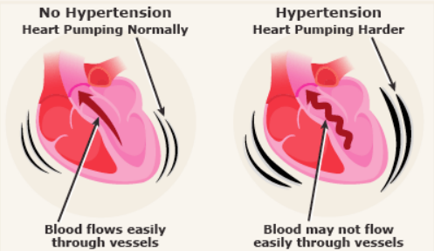
RISK FACTORS
High blood pressure - The arteries in the body are impacted by the prevalent condition of high blood pressure. The blood's constant pressure against the artery walls is too high if you have high blood pressure. To pump blood, the heart must work harder.
High blood stress can be related to dementia.
Young humans will have excessive blood stress, too.
High blood stress typically doesn`t have any symptoms.
Many humans who've excessive blood
stress don`t understand it.
Women and African Americans face dangers in relation to
excessive blood stress.

Slide 6
Machine learning algorithm
The algorithms that transform a data set into a model are known as machine learning algorithms, and they are the heart of machine learning. The best algorithm (supervised, unsupervised, classification, regression, etc.) will rely on the type of problem you are trying to solve, the processing power you have, and the type of data you have.
Decision tree classifier
A decision tree can be used in decision analysis to reflect decisions and decision-making formally and visually. In data mining, a decision tree describes data but not decisions; the resulting classification tree can be an input for decision-making

Slide 7
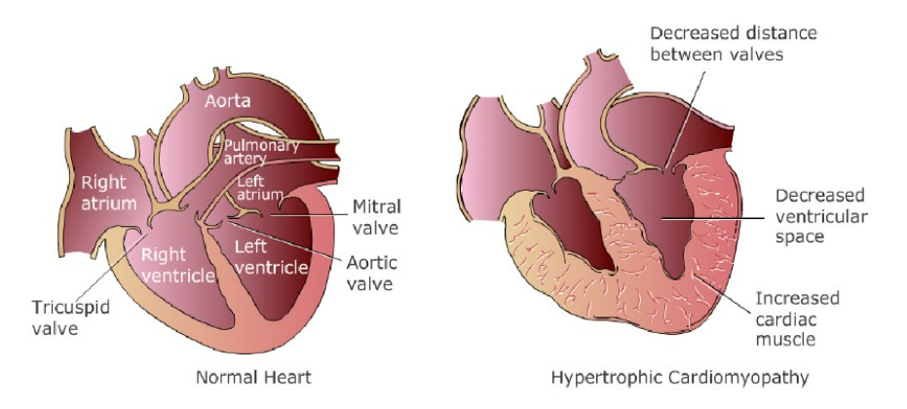
Normal heart or Heart with Dilated Cardiomyopathy

Slide 8
K nearest neighbour
K Nearest Neighbour is a simple algorithm that stores all the available cases and classifies the new data or case based on a similarity measure. It is mostly used to classifies a data point based on how its neighbour are classified.
Support vector
It is a type of deep learning algorithm that performs supervised learning for classification or regression of data groups.
Random forest
Regression and classification both employ Random Forest methods. It organises the data into a tree and bases its predictions on it. Even when significant portions of record values are missing, the Random Forest algorithm can still produce the same results when applied to huge datasets.

Slide 9
References
[1] S. M. Reza, M. M. Rahman, M. H. Parvez, M. S. Kaiser, and S. Al Mamun, “Innovative approach in web application effort & cost estimation using functional measurement type,” in 2015 International Conference on Electrical Engineering and Information Communication Technology (ICEEICT). IEEE, 2015, pp. 1–7.
[2] P. Govindarajan, R. K. Soundara pandian, A. H. Gandomi, R. Patan, P. Jayaraman, and R. Manikandan, “Classification of heart stroke disease using machine learning algorithms,” Neural Computing and Applications, vol. 32, no. 3, pp. 817–828, Feb. 2020.
[3] C.V. Krishna Veni, T. R. Shoba, On the classification of imbalanced Datasets, International Journal of Computer Science & Technology 2011; 2:145-148
[4]. Turkmen HI, Karsligil ME. Advanced computing solutions for analysis of laryngeal disorders. Medical & biological engineering & computing. 2019 Nov;57(11):2535-52.

Slide 10


